Slide 1

Crossplane vs Kubebuilder
paradigms, abstraction, complexity, extensibility and performance comparison with a common use case implementation
Infrastructures for Cloud Computing and Big Data M
Lorenzo De Luca
0001240461

Slide 2


Kubernetes Operators
A Kubernetes Operator extends the Kubernetes API with a Custom Resource(CR) and a controller. Operators implement the reconciliation loop pattern: they observe Custom Resources through the Kubernetes API server, compare desired and actual state, and perform actions until convergence.
Building operators can be approached at different levels of abstraction:
Low-level: the developer writes all the controller logic
High-level: the developer describes the desired infrastructure API and composition logic, while existing controllers/providers perform reconciliation.
Both approaches solve the same problem of automating resource lifecycle but target different users and different tradeoffs.
Notes:
Some background… k8s is widele extensible with operators and they can when choosing to create a new one there are two categories to choose from, the

Slide 3
Research Objective
Compare Crossplane and Kubebuilder as representatives of two paradigms for building Kubernetes Operators.
Will be evaluated:
Architectural model and abstraction level
Development complexity and extensibility
Internal optimizations adopted by each framework
Resource consumption
Does the convenience of the extra abstraction layer of Crossplane cost more in resources/latency than it saves in development effort, compared to a hand-written Kubebuilder controller?
Notes:
Some background…

Slide 4
Crossplane
Universal control plane
Declarative composition model
Strong for composition and platform engineering
Logic is mostly declarative
Strength: consistency and reuse
Limitation: less flexible for complex imperative logic
Notes:
Control plane framework, declarative model, composition. Internal Development Platform

Slide 5

Kubebuilder
Low-level Go SDK
Imperative control model
Strong for writing specialized controllers from scratch
Logic in Go
Strength: maximum flexibility
Limitation: higher coding and maintenance effort
Notes:
build custom Kubernetes operators, Infrastructure behavior is explicitly defined, domain-specific

Slide 6
Architecture
Crossplane
Kubebuilder
User applies a Claim or Composite Resource
User applies a Custom Resource
Crossplane composition controller observes the resource
Controller-runtime informer watches the API server
Composition is rendered into composed Managed Resources
Events are added to a work queue
Reconcile() executes custom Go logic and directly creates/updates Kubernetes or external resources
Providers reconcile each Managed Resource against Kubernetes or external systems
Status aggregated bottom-up:
Provider -> MR -> XR → Claim
Status written directly by Reconcile() to the Custom Resource status
Notes:
Implications:
- Crossplane introduces more API objects and more reconciliation hops.
- Kubebuilder has fewer layers, but all lifecycle logic must be implemented manually.
- Crossplane favors modularity and reuse; Kubebuilder favors direct control and lower overhead.

Slide 7
Features comparison
Aspect | Crossplane | Kubebuilder
Abstraction | High (declarative) | Low (imperative)
Architecture | Multi-layer | Single controller
Development effort | Lower | Higher
Extensibility | Providers, Functions, patching | Arbitrary code, any library
Flexibility | Medium | Very high
Reusability | High | Low
Performance | Higher overhead | More efficient
Debugging | Harder | Easier (centralized)
Notes:
Key architectural difference to call out: Kubebuilder has one reconciliation loop; Crossplane has N independent loops (engine, one per Provider, one per Function) that must all converge before the Claim is "ready."

Slide 8
Optimizations
Crossplane:
Uses Kubernetes controller patterns internally: informers, caches, work queues and rate limiting.
Providers reconcile managed resources independently, enabling parallel and modular reconciliation.
Leader election avoids duplicate reconciliation in replicated controller deployments.
Kubebuilder:
Informer cache: most Kubernetes object reads are served from a local cache, reducing API-server load
Uses a rate-limited work queue with backoff after repeated errors.
Supports event predicates and MaxConcurrentReconciles for tuning reconciliation load.
Notes:
Both frameworks rely on Kubernetes controller patterns such as informers, caches and work queues. The difference is where the optimization happens. Crossplane distributes reconciliation across multiple reusable controllers and providers. Kubebuilder gives the developer direct control over the reconciler, so optimizations such as event filtering, skipping updates or tuning concurrency must be implemented or configured manually.
Kubebuilder: The pattern is simple: after each failure, wait twice as long as the previous attempt before retrying. both frameworks avoid busy-polling, but Crossplane's optimizations are distributed across more components. which is one hypothesis for higher steady-state resource use, tested next.

Slide 9
So… Which one is better? It depends…
Scenario | Better choice | Reason
Standard infrastructure composition | Crossplane | Declarative and reusable
Internal Developer Platform | Crossplane | User-friendly claims and abstractions
Multi-resource self-service APIs | Crossplane | Composition model fits well
Complex conditional logic | Kubebuilder | Full control in Go
Custom external API integration | Kubebuilder | Any Go library can be used
Fine-grained lifecycle control | Kubebuilder | Reconciliation is fully programmable
Provisioning latency | Kubebuilder | Fewer controller layers
Debuggability | Kubebuilder | Less layers, more control
Notes:
It depends… obv

Slide 10
Kafka Topic Self-Service
Code and raw data obtained:
https://github.com/lorenzodeluca/kafka-operator-clash

Slide 11
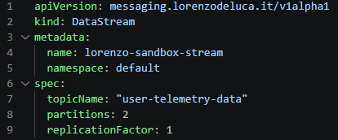
Common goal
The goal for the implemented operators is to create a new Kafka topic. Instead of manually creating all required resources, the user declares a single object called DataStream.
When a DataStream is created, the operator must automatically provision and reconcile a ready-to-use data pipeline: a Kafka topic where data can flow, a configuration file with the connection details, and a small consumer application that reads the connection details generated by the operator.
DataStream example:
Notes:
Control plane framework, declarative model, composition. Internal Development Platform

Slide 12
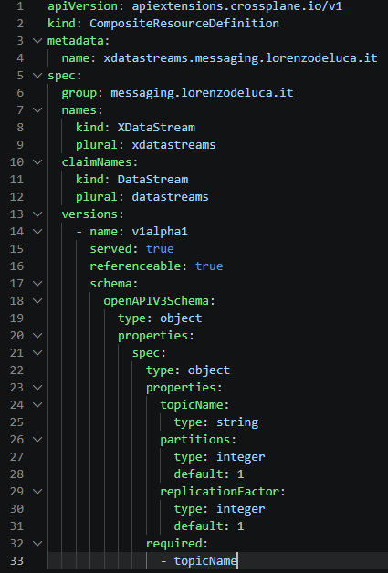
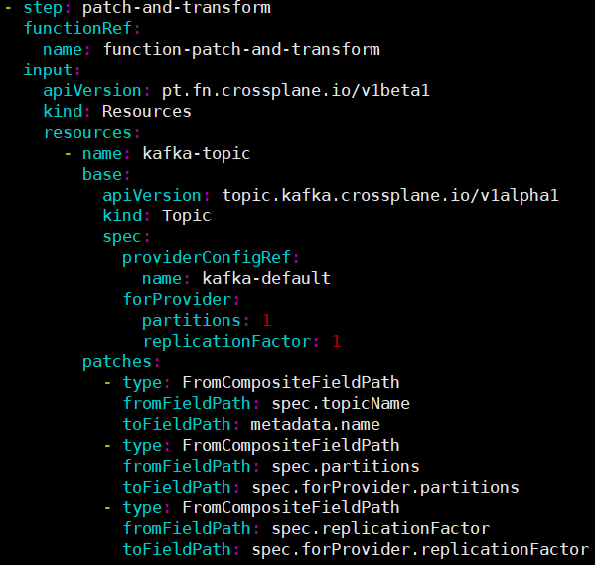
Crossplane implementation
Kafka Topic
K8s ConfigMap
K8s Deployment
USER
DataStream
CROSSPLANE
Composition
XDataStream
(Claim)
(XR)
(Managed Resources)
api/datastream_xrd.yaml:
compositions/datastream_composition.yaml
Kafka provider
Kafka Topic
ConfigMap
Deployment
K8s provider
Notes:
Control plane framework, declarative model, composition. Internal Development Platform

Slide 13
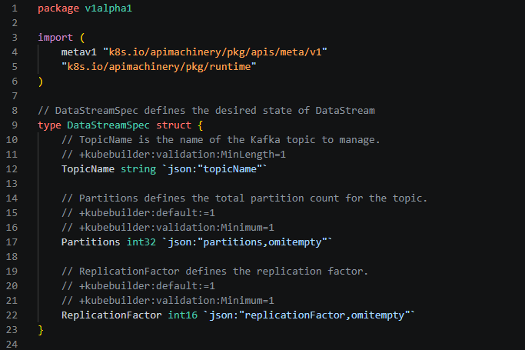
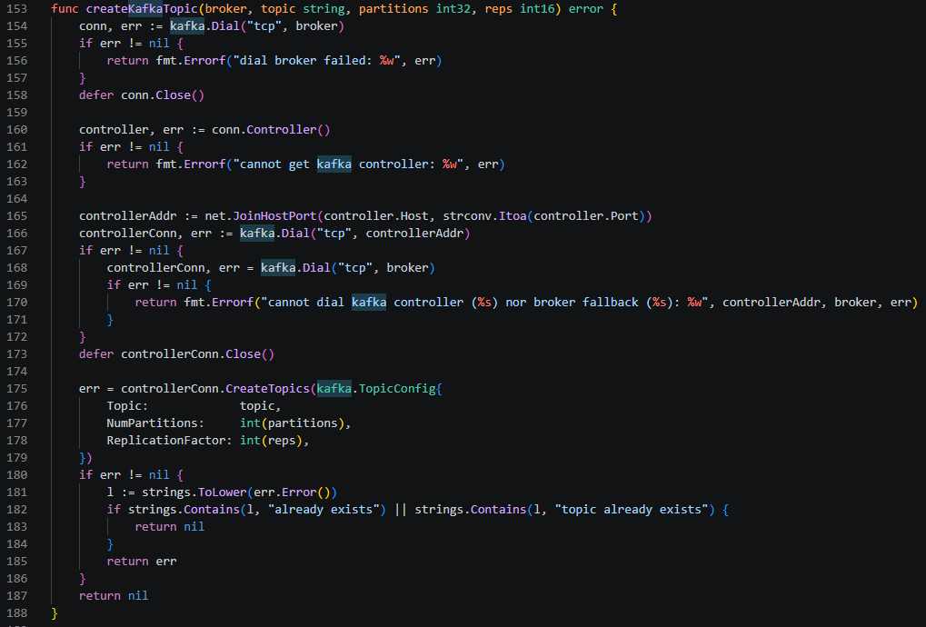
Kubebuilder implementation
Kafka Topic
K8s ConfigMap
K8s Deployment
USER
DataStream
Kubebuilder
datastream_types.go:
datastream_controller.go:
Notes:
Control plane framework, declarative model, composition. Internal Development Platform

Slide 14
Performance results
Metric | Crossplane | Kubebuilder
Lines of code written* | 165 | 270
Manually edited files | 7 | 2
Avg time to ready state (seconds)** | 6 | 2
At rest CPU usage (millicores) | 7 | 1.73
At rest RAM usage (MiB) | 384 | 51.5
Environment:
Debian VPS: 8 vCPU, 8 GB RAM, 75GB SSD
Local k3s cluster
Single Kafka broker
Controllers/providers already running
Crossplane components running in-cluster
Kubebuilder controller running as host process with ’make run’
Metrics collected through `kubectl top` for pods and ’/proc’ for Kubebuilder
* Excluding generated code and provider installation/configuration manifests. The metric is indicative only since Crossplane shifts complexity to providers and platform configuration, while Kubebuilder concentrates complexity in the controller code.
** The measured time is the elapsed time between applying the DataStream resource and observing the expected ready state. Ready state means that the framework-reported DataStream/Claim is Ready and the expected Kafka topic, ConfigMap and Deployment are observable.
Notes:
Control plane framework, declarative model, composition. Internal Development Platform

Slide 15
Resources consumption
X-axis: batch size, the number of DataStream resources created together
Y-axis: average CPU rate (millicores)/RAM usage(MiB) each component sustained while it was actively reconciling that batch
*Crossplane measurements include the control-plane components used in the experiment: Crossplane core, provider-kafka, provider-kubernetes and function-patch-and-transform.
Notes:
Control plane framework, declarative model, composition. Internal Development Platform

Slide 16
Resources: Crossplane components
X-axis: batch size, the number of DataStream resources created together
Y-axis: average CPU rate (millicores)/RAM usage(MiB) each component sustained while it was actively reconciling that batch
Notes:
function-patch-and-transform è stateless (nessuna cache di oggetti tracciati) — le variazioni osservate riflettono il comportamento del garbage collector Go in idle, non una relazione reale con la batch size, a differenza delle componenti con cache persistente.

Slide 17
REFERENCES
The Kubebuilder Book, https://book.kubebuilder.io
Crossplane documentation, https://docs.crossplane.io/v2.3
kafka-go, https://github.com/segmentio/kafka-go

Slide 18
Questions?
Thank you for your attention

Slide 19
Crossplane Architecture
Multi-layer control plane:
- Claim/user API
- Composite Resource (XR)
- Composition
- Managed Resources
- Providers (to access external systems)
Each layer has its own controller and reconciliation loop
Notes:
Strong separation of the layers, Multiple reconciliation layers introduce overhead

Slide 20
Kubebuilder Architecture
Single-layer architecture:
- Custom Resource (XR)
- Controller (Reconciler)
The controller directly interacts with the Kubernetes api and external systems
Notes:
Strong separation of the layers, Multiple reconciliation layers introduce overhead

Slide 21
Resource Management
Crossplane
Kubebuilder
Layered model
Direct control
The user creates a high-level custom resource describing the desired service. Crossplane uses a Composition to generate composed resources, while providers reconcile those resources against Kubernetes or external systems.
The controller directly reconciles the Custom Resource and target resources
Providers
Custom logic
Providers manage external or K8s resources through standard interfaces. They handle authentication, external api calls and controller logic.
The reconciler can use any Kubernetes client or external API client
Status managed through Crossplane
Status managed in code
Ownerships and status aggregation are managed through Crossplane mechanisms
Ownership references, status conditions, and lifecycle logic are managed in code
Notes:
Crossplane standardizes multi-resource orchestration; Kubebuilder gives direct control over every reconciliation step.

Slide 22
Abstraction
Crossplane
Kubebuilder
High-level Abstraction
Low-level framework
User declares the desired state using a custom API
Developer defines how the desired state is reached.
Declare the desired infrastructure
Explicit control over lifecycle
The user only creates a high-level custom resource, the internal resources are generated by the Composition.
The controller directly manages the resources, status updates and error handling.
Notes:
Crossplane standardizes multi-resource orchestration; Kubebuilder gives direct control over every reconciliation step.

Slide 23
Extensibility
Crossplane
Kubebuilder
Extensible through components
Extensible through coding and external libs
Extensible through Providers, Functions, patching, and transformations
Extensible through arbitrary Go code and external libraries
Optimized for reusability
Optimized for specific domains
Encourages API standardization across teams. Ideal for creating Internal Development Platforms
Best for complex, conditional, or stateful workflows
Easier for standard composition scenarios
Easier for custom logic
The standardized composition model makes it easy to define new platform APIs without writing a dedicated controller.
Better debuggability in Go due to the concentrated logic.
Notes:
Crossplane standardizes multi-resource orchestration; Kubebuilder gives direct control over every reconciliation step.

Slide 24
Developer Interface
Crossplane
Kubebuilder
Declarative YAML Composition
Imperative GO Logic
Abstractions are built using schemas written in declarative YAML declarations
The controller code is written with standard backend code
Additional functions
Direct control
Additional conditional transformations can be used via functions built in imperative languages
The controller directly reconciles the Custom Resource and target resources. The reconcile logic is completely customizable
Easier to implement
Maximum flexibility
The standardized framework makes it easy to implement the new controller.
Maximum flexibility, but increased maintenance responsibility

